Slide 1
Lecture 18
Fuzzy Logic
Yaohang Li
Department of Computer Science
ODU
Reading for This Class:
Chapter 7, 8, 9, Russell and Norvig

Slide 2
Review
Last Class
First Order Logic
This Class
Fuzzy Logic
Next Class
Swarm Intelligence

Slide 3

Fuzzy Logic vs. Traditional Logic
Traditional Logic
Boolean (Binary)
Either True or False
Traditional Logic is Limited
The real world is not all True and False
Linguistic terms
“Tall”
“Fast”
“Large”
Fuzzy qualifier
“Very”
“More or less”
“Slightly”
We need a representation that provides for approximate reasoning and fuzzy terminology

Slide 4
A Little History of Fuzzy Logic
Aristotle and Plato
Aristotle
“Law of the Excluded Middle”
Every proposition must be either True or False
Plato
Allowed for a third region where opposites “tumbled about”
Early 20th Century
Lukasiewicz proposed 3-valued logic (0, 1, 2) as an alternative to (F, T)
In 1960’s Lotfi A. Zadeh Ph.D., University of California, Berkeley, published an obscure paper on fuzzy sets
Unconventional theory for approximate information and uncertainty when generating complex solutions
In 80’s and 90’s, fuzzy logic was widely adopted in intelligent control system

Slide 5
Understanding Fuzzy Logic
Fuzzy Logic is a method of logic that allows the computer to express and process statements that are ambiguous
Degree of truth
The computer understands only two possible states, either on, represented by the number 1, or off, represented by the number 0
Fuzzy logic systems have been successfully implemented in many devices that use embedded computers
Found in control system
Found in appliance
Washing machines
Refrigerator

Slide 6
What is Fuzzy Logic?
An extension of conventional (Boolean) logic that deals with concepts of ‘partial truth’
More like human reasoning
approximate reasoning vs. exact reasoning
Uses continuous values in the range [0, 1]
Using set theory:
Conventional: a value is either in the set or not
these are ‘crisp’ sets
Fuzzy: a value has a ‘degree of membership’ between 0 and 1 for any set

Slide 7
Membership Function of A Fuzzy Set
Fuzzy sets describe vague concepts (fast runner, hot weather, weekend days).
A fuzzy set admits the possibility of partial membership in it. (Friday is sort of a weekend day, the weather is rather hot).
The degree an object belongs to a fuzzy set is denoted by a membership value between 0 and 1. (Friday is a weekend day to the degree 0.8).
A membership function associated with a given fuzzy set maps an input value to its appropriate membership value.

Slide 8
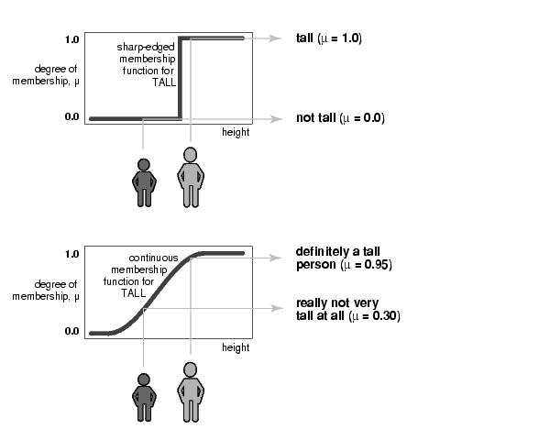
Example of Membership Function

Slide 9
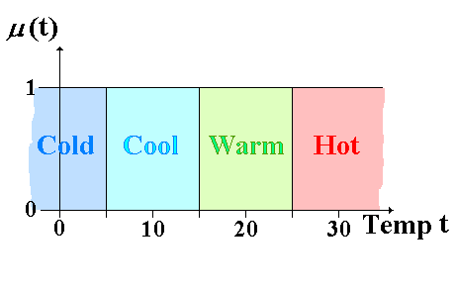
Crisp Sets
Any value is strictly within one of the sets
e.g. 12.9° has membership 1 for ‘Cool’ and 0 for all other sets
IF (5 < x ≤ 15) THEN …

Slide 10
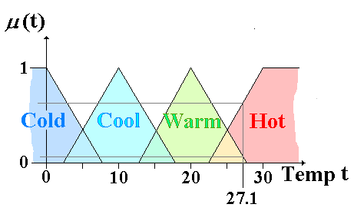
Fuzzy Sets
Values belong to each set with a degree of membership
E.g. 27.1° has membership 0.1 for ‘Warm’ and 0.6 for ‘Hot’ (0 for others)

Slide 11
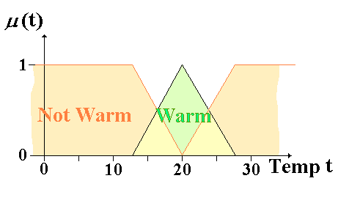
Negation
Complement (Negation)
If x belongs to set A with membership μ_{A}(x), then the negation of this (x does NOT belong to set A) is 1 - μ_{A}(x)

Slide 12
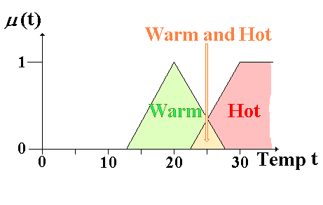
Conjunction
Intersection (minimum)
If x belongs to set A with membership μ_{A}(x) and to set B with membership μ_{B}(x) then the conjuction (x belongs to set A AND set B) is min(μ_{A}(x), μ_{B}(x))

Slide 13
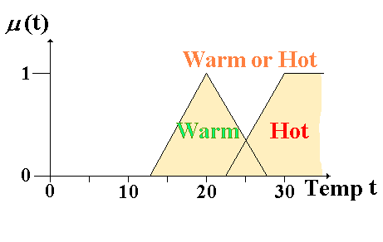
Disjunction
Union (maximum)
If x belongs to set A with membership μ_{A}(x) and to set B with membership μ_{B}(x) then the disjunction (x belongs to set A OR set B) is max(μ_{A}(x), μ_{B}(x))

Slide 14
Other Operators & Rules
Fuzzy logic is an extension of conventional logic
{NOT, AND, OR} form a complete set of operators
so we can define all the other logical operators
The following ‘rules’ apply
Commutativity
Associativity
De Morgan’s Laws

Slide 15
Example
Fuzzy sets : young, middle aged and old
Mid
Age
A2
Not Young
A1
Not Old
A3
Membership
Age
0
20
35
45
60
80
A2 = A1 ∩ A3

Slide 16
Truth Table
Conventional Logic
Fuzzy Logic
P | Q | ¬P=1-P | P∧Q=Min(P, Q) | P∨Q=Max(P, Q) | P⇒Q=Min(1,1-P+Q)
0 | 0 | 1 | 0 | 0 | 1
0 | 1 | 1 | 0 | 1 | 1
1 | 0 | 0 | 0 | 1 | 0
1 | 1 | 0 | 1 | 1 | 1
P | Q | ¬P=1-P | P∧Q=Min(P, Q) | P∨Q=Max(P, Q) | P⇒Q=Min(1,1-P+Q)
0.0 | 0.7 | 1.0 | 0.0 | 0.7 | 1.0
0.6 | 0.3 | 0.4 | 0.3 | 0.6 | 0.7
1.0 | 0.2 | 0.0 | 0.2 | 1.0 | 0.2
0.9 | 0.1 | 0.1 | 0.1 | 0.9 | 0.2

Slide 17
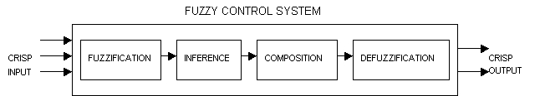
Fuzzy Logic in Intelligent Control System
Fuzzification
Crisp input values are transformed into fuzzy sets to be able to use them for computing the truth-values of the premise of each rule in the rule base.
Inference
The truth-value for the premise of each logic rule is computed and applied to the conclusion part of each rule. This results in one fuzzy set to be assigned to each output variable for each rule.
Composition
All of the fuzzy sets assigned to each output variable are combined together to form a single fuzzy set for each output variable.
Defuzzification
The single fuzzy sets are converted back to crisp values.

Slide 18
Fuzzification

Slide 19
Fuzzy Rules
An AC Controller
If HOT then DECREASE A LOT
If WARM then DECREASE A LITTLE
If COOL then INCREASE A LITTLE
If COLD then INCREASE A LOT
Note: the outputs are also represented as fuzzy sets

Slide 20
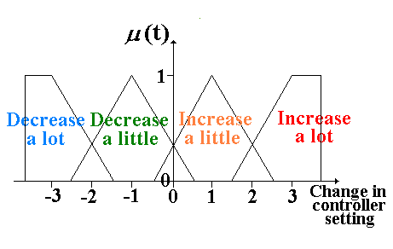
Fuzzy Outputs
We still need to arrive at an actual ‘answer’
e.g. For a given temperature, how much should the controller setting be changed?
So we need a process of ‘defuzzification’

Slide 21
Fuzzy Logic Example
e.g. a temperature of 27.1° is sensed
27.1° had fuzzy membership values 0.1 for WARM and 0.6 for HOT
‘If WARM then DECREASE A LITTLE’
Membership 0.1 for output INCREASE A LITTLE
‘If HOT then DECREASE A LOT’
Membership 0.6 for output DECREASE A LOT
Other outputs (INCREASE A LITTLE, INCREASE A LOT) have membership 0

Slide 22
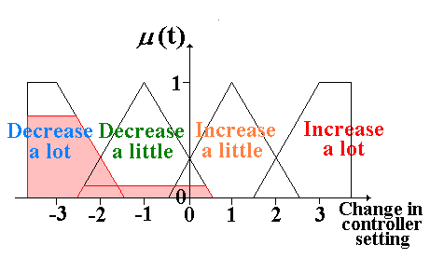
Fuzzy Logic Example (2)
We now need to use this fuzzy information to find the actual value by which the controller setting needs to be changed…

Slide 23
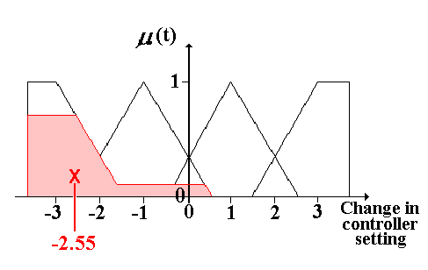
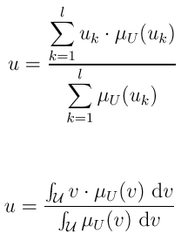
Defuzzification
Find the Centre of Gravity
Other methods of defuzzification are possible (e.g. use the mean maximum value)

Slide 24
Composition
Under composition, all of the fuzzy sets assigned to the conclusion part of the rules under inference, are combined together to form a single fuzzy subset for every term in the term set of the output variable.

Slide 25
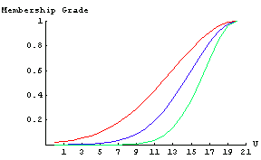
Extensions to Fuzzy Sets
Concepts such as VERY, SLIGHTLY, etc can be modelled
e.g if x has membership μ(x) for HOT, it could have membership (μ(x))² for VERY HOT, or √(μ(x)) for FAIRLY HOT
Such functions are sometimes known as ‘hedges’

Slide 26
Summary
Literal
Unit Resolution Rule
Full Resolution Rule
Logical Entailment based on Full Resolution Rule
First Order Logic
Fuzzy Logic
Fuzzy Logic vs. Conventional Logic
Fuzzy Set
Membership Function
Negation
Conjunction
Disjunction
Apply Fuzzy Logic to AI Control System
Fuzzification
Fuzzy rules
Composition
Defuzzification

Slide 27
Summary
First Order Logic
Language
Components
Terms
Sentence
Expressions in First Order Logic

Slide 28
What I want you to do
Review Chapter 7, 8, 9
Work on your assignment
Work on your term project
Be well prepared for your midterm

